Slide 1

CS 5542
Controlled Image Generation & Speech Intelligence
Presented by: Tina Nguyen
Notes:
"Hello everyone, my name is Tina Nguyen. Today I’ll be presenting my work for CS 5542, covering both Quiz Challenge 1 and Quiz Challenge 2.
These projects explore two very different but equally exciting areas of AI: generative computer vision for e-commerce, and multimodal speech intelligence. Let's start with the visual side."

Slide 2

QUIZ 1
Controlled E-Commerce Image Generation
Notes:
"For Quiz 1, I focused on 'Controlled E-Commerce Product Image Generation.'

Slide 3



CONTEXT & METHODOLOGY
The Challenge
Our Methodology
E-commerce product photography is prohibitively expensive. While generative AI (SDXL) offers a solution, it is notoriously unpredictable in styling and structural consistency.
We injected metadata (category, material, style) into a rigid prompt template, comparing Naive Prompting against Structured Prompt Engineering.
The Strategic Goal
To enforce strict visual consistency (lighting, background, and perspective) across a diverse and high-volume product catalog using deterministic evaluation.
Notes:
In the e-commerce industry, high-quality product photography is expensive. Generative AI models like Stable Diffusion are powerful but highly unpredictable. If you just ask for a 'coffee mug,' you might get a great image, but it won’t match the uniform, professional studio style needed for a catalog.

Slide 4
QUANTITATIVE EVALUATION
Metric Type | Naive Prompting | Structured Prompting | Delta Improvement
Text Alignment (CLIP) | 0.281 | 0.284 | +1.1%
Visual Consistency (SSIM) | 0.360 | 0.442 | +22.8%
Structural Stability | Variable | Rigid/Consistent | High Impact
*Dataset: 10 diverse e-commerce products evaluated across 3 deterministic seeds.
Notes:
To solve this, I designed an experiment to compare two approaches: Naive Prompting versus Structured Prompt Engineering. I built a pipeline that reads product metadata—like category, color, material, and style—and injects it into a strict template. This forces the AI to use specific studio lighting and a solid white background.

Slide 5
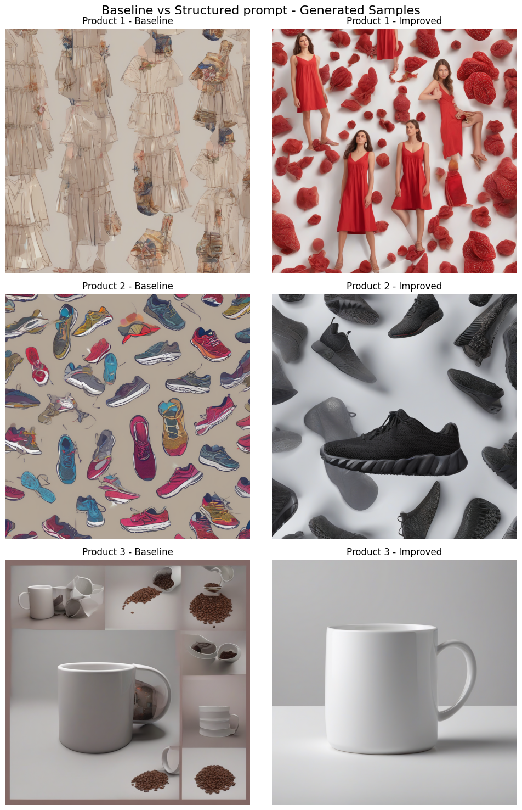
CONSISTENCY IMPACT
+22.8%
Improvement in SSIM Scores
Structured prompts proved exceptionally effective for solid objects (mugs, sneakers) by stabilizing geometry and lighting.
Note: Complex geometries like shoes remain a challenge for current prompting techniques.
Notes:
To scientifically test consistency, I generated images for 10 diverse products across 3 deterministic seeds. I evaluated the results programmatically using CLIP score for text-alignment and SSIM for visual consistency.
The findings were fantastic: While the text-alignment stayed strong in both, the structured prompting increased visual consistency by nearly 23%! It worked exceptionally well for solid objects like mugs and smart speakers, proving that structured prompting creates the reliable uniformity needed for digital storefronts."

Slide 6
QUIZ 2
AI Speech Intelligence Autonomous Pipeline
Notes:
"Now, shifting gears from vision to audio, let’s talk about Quiz 2, where I built an automated AI Speech Intelligence Pipeline."
"For this second challenge, the goal was to process a 32-second technical lecture audio file and extract meaningful insights.

Slide 7






THE MULTIMODAL ARCHITECTURE
7-Model Chain
Intelligence Loop
Structured Data
Orchestrated 7 different Hugging Face models into a unified processing loop.
Full autonomous loop: Speech to Text to Summary to synthesized Voice.
Outputting clean JSON with regex-parsed action items and sentiment analysis.
Notes:
I built a completely autonomous pipeline that chains together 7 different HuggingFace models.

Slide 8
THE EXECUTION PIPELINE
Whisper
BART
DistilBERT
MarianMT
SpeechT5
High-fidelity Transcription
Contextual Summarization
Sentiment Analysis
Multilingual Translation
Audio Synthesis
Notes:
First, it uses Whisper to transcribe the audio. Then, BART summarizes the text, and DistilBERT runs sentiment analysis to flag any negative sentences. Finally, MarianMT translates the summary into Spanish, and SpeechT5 synthesizes it back into audio narration.

Slide 9
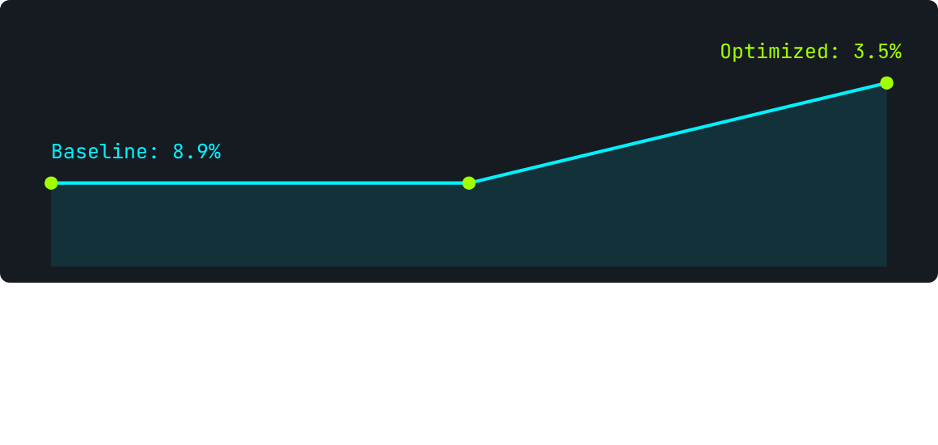


OPTIMIZING WORD ERROR RATE (WER)
Adding a domain-aware initial prompt to Whisper reduced transcription errors by a massive 61%.
Strategic prompting achieved this reduction without retraining the model or increasing compute latency.
Notes:
The main challenge in the pipeline was transcription accuracy, so we focused on optimizing the Word Error Rate, or WER. We achieved a massive 61% reduction in transcription errors simply by using a strategic, domain-aware initial prompt when calling Whisper. Crucially, this improvement was achieved without requiring any model retraining or increasing the compute latency of the pipeline.

Slide 10


EXTRA CREDIT: MULTIMODAL LOOP
The pipeline successfully closed the multimodal loop by synthesizing insights back into high-quality speech.
Actionable JSON output
Regex-parsed action items
Spanish Translation synthesis
Notes:
The extra credit challenge involved successfully closing the multimodal loop. We took the summarized and processed insights and synthesized them back into high-quality speech using SpeechT5. The final output wasn't just raw text; it was structured, actionable JSON containing regex-parsed action items and the synthesized Spanish translation.1

Slide 11
STRATEGIC TAKEAWAYS
Strategic Prompting is Paramount: Whether in Vision (SDXL) or Audio (Whisper), structured prompts are the primary driver of reliability.
The Power of Orchestration: Chaining modular components enables end-to-end autonomous processing for complex human-centric tasks.
Data-Driven Reproducibility: Success was validated through deterministic seeds and rigorous metrics (SSIM, CLIP, and WER).
Notes:
To wrap up, there are three strategic takeaways from both challenges. First, Strategic Prompting is Paramount: whether we're using Stable Diffusion for image generation or Whisper for audio, structured prompts are the primary driver of reliability. Second is the Power of Orchestration: successfully chaining modular AI components, such as the seven models in Quiz 2, enables end-to-end autonomous processing for complex, human-centric tasks. Finally, our success was confirmed through Data-Driven Reproducibility, validated using rigorous metrics like SSIM, CLIP, and Word Error Rate

Slide 12

Thank You!
Any Questions?
Tina Nguyen
Notes:
"In conclusion, whether we are controlling the visual consistency of Stable Diffusion or chaining language models for speech intelligence, both projects highlight how strategic prompting and pipeline design can vastly improve AI reliability.
Thank you so much for your time, and I’d be happy to answer any questions!"

